Slide 1
Gender pay gap
and the influence of education level on it

Slide 2

Gender disparities
Gender inequality remains a significant global issue. To address this challenge, we, a group of data analysts, gather together to help identify, understand, and propose data-driven solutions to close the gender gap across various dimensions, such as education, employment, pay, and representation.
The objective is to use data analytics to reveal insights and provide actionable recommendations to reduce gender disparities.

Slide 3


1. Synopsis
Our research is based on Glassdoor's platform. Our primary focus is to investigate potential disparities in salary between male and female employees in the Netherlands. Additionally, we intend to explore the influence of key factors, such as educational attainment and age, on these potential wage discrepancies.
Our research encompasses a substantial sample size, consisting of 1,000 job vacancies.

Slide 4
2. Questions:
What is the impact of educational level on average salary per year (base pay+bonus) for females and males?
How does average salary per year (base pay+bonus) differ between females and males in the same positions?
Does age affect salary for females and males?

Slide 5
SUMMARY
Female average salary per year is 8.1% less than male

Slide 6
What is the impact of
educational level on average salary per year
(base pay+bonus)
for females and males?
Note
We’ve analyzed
College,
High School.
Masters and
PhD levels

Slide 7
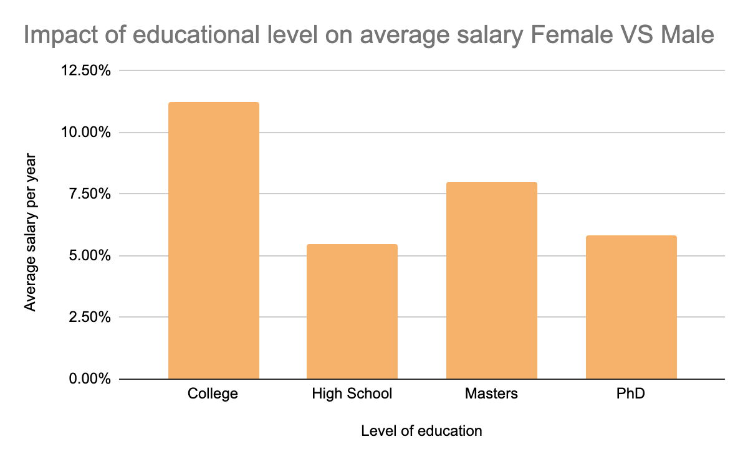
The most underrated female college graduates. Here the salary gap is 11.23%

Slide 8
How does average salary per year (base pay+bonus) differ between females and males in the same positions?
Note
We’ve analyzed
College,
High School.
Masters and
PhD levels

Slide 9
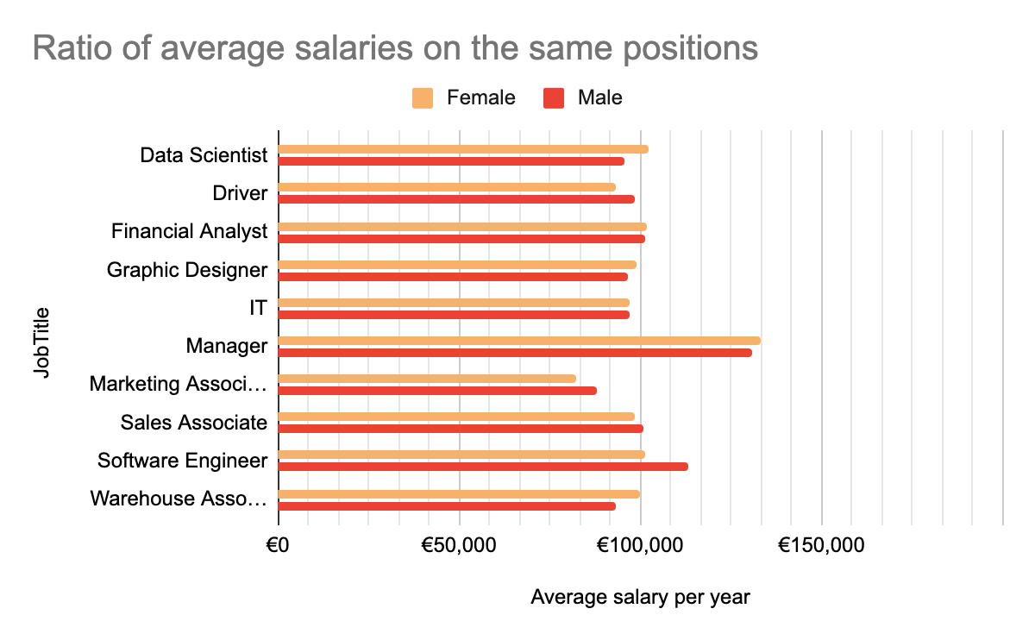

Slide 10

Conclusions.
Females receive higher salary on
positions Data Scientist and Warehouse Associate
Females receive lower than average salary on positions
Driver and Software Engineer
Males receive higher than average salary on positions
Driver, Marketing Associate.
Males receive lower than average salary on positions
Data Scientist and Warehouse Associate.
From all positions, Females receive 4.48% less
then Males

Slide 11

Does age affect salary for females and males?

Slide 12

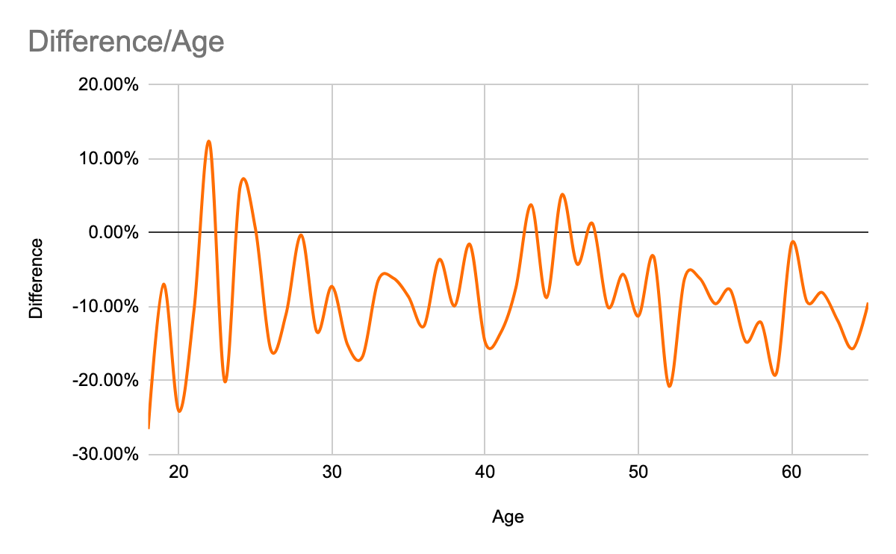

Slide 13
Conclusions.
At the age of 18-20, men's salaries lead by a large margin
(till 19.2%).
At the age of 22, women earn more than men
(up to 12.29%)
Also, the salary of women is more attractive at the age of
45.
But from the age of 48 (and especially at the age of 52)
men have the most attractive salaries
(up to 20.75% difference)

Slide 14
Suggestions
College graduated woman should be supported.
The women on the positions “Driver” and “Software engineer” should be promoted faster to erase salary gap between man and women on that position.

Slide 15

Suggestions
Since the period during which women earn more than men is very small (ages 22-24 and 43-47), we propose to introduce additional subsidy programs for young women (from 18 to 22 years). We also offer support programs for women over 48 years old.

